Slide 1
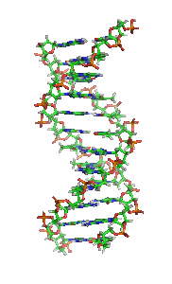
Basics of DNA
Wes Harkins
Georgia Highlands College Cartersville SP14

Slide 2
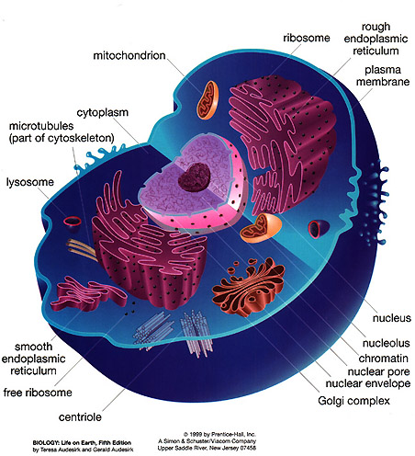
Cellular composition
DNA is contained in nucleus of cell
Phospho-lipids and proteins combined to form cell membrane
Lipids are fats

Slide 3
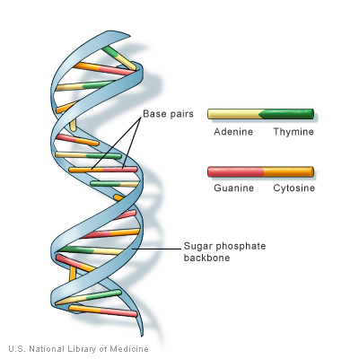
DNA (DeoxyriboNucleic Acid) is a double helix
Backbone is made of sugar-phosphate
Base pairs bind the backbone together
Adenine always pairs with Thymine
Guanine binds with Cytosine

Slide 4
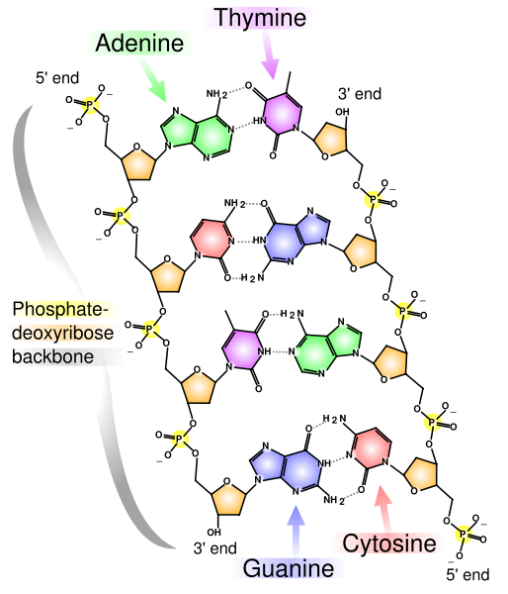
Base pairs
A=T – double hydrogen bond
G C – triple hydrogen bond
Nucleotide (3 chemical groups)
  Sugar – deoxyribose
    contains 5 Carbon atoms
  Phosphate group
  A base (A, T, G, C)

Slide 5
Extracting DNA from an onion
Papain (enzyme) is found in meat tenderizer
  destroys cell membrane
Detergent – breaks down lipids in cell membrane
Ethanol and heat shock?

Slide 6
DNA replication/synthesis
DNA has a lagging strand 3’-5’ and a leading strand 5’-3’
The 5’ end matches with a 3’ end in a double helix
DNA replication occurs every 20 minutes in E. coli (widely used to reproduce DNA)
Copying DNA molecule
Each DNA strand (double helix) unzips itself
Happens before cell division (mitosis and meiosis)
Done in PCR (polymerase chain reaction) to make a lot of the same DNA (mass replication) for analysis through fingerprinting.

Slide 7
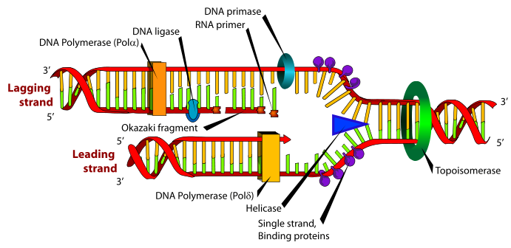
DNA replication

Slide 8
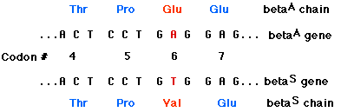
Mutations
Caused by chance, genes, and environment
  ultraviolet light
  tobacco/alcohol
  change in genetic coding of amino acids
Types
  insertion
  deletion
  substitution
  inversion (flipping)
Sickle cell anemia
Notes:
Sickle cell anemia – A substitution by a T at the 17th nucleotide of the gene for the beta chain of hemoglobin

Slide 9
http://www.johnkyrk.com/meiosis.html
Aneupliody – change in number of chromosomes leads to chromosomal disorders
  Downs syndrome – extra 21st chromosome
  Edwards syndrome – three chromosome 18
    50% die in uteuro
    25% die by 2 months
    5-10% survive 1 year.
  Patau Syndrome – trisomy (3) of chromosome 13
  All other chromosomal abnormalities are fatal in uteuro

Slide 10
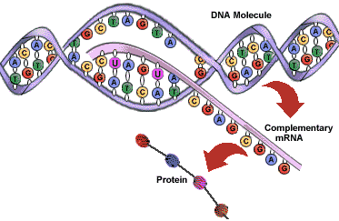
Transcription
DNA is copied to RNA
T is changed to a U
So then A bonds with a U (Uracil)
Proceeds in the 5’-3’ position
mRNA – leaves nucleus as a copy and codes for an amino acid (translation)

Slide 11
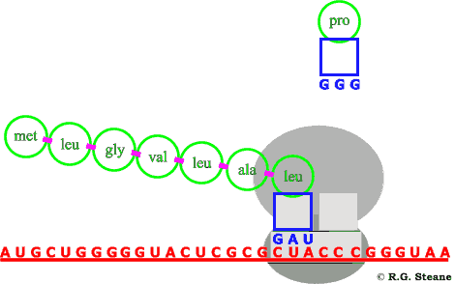
Translation
occurs within the cytoplasm of cell
tRNA – transfer RNA
decodes information from mRNA to produce amino acids
3 codons translate to an amino acid
Translation animation

Slide 12
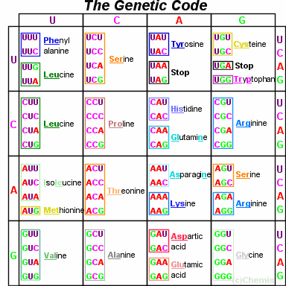
Amino Acid
A chain of nucleotides makes a codon (3 letter word such as ATT, GCA
Each codon makes an amino acid (20 essential Amino Acids)
“Stop” codons means translation stops and a gene is complete

Slide 13
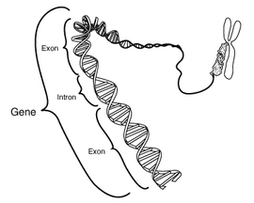
Genes
Chromosome
A string of codons codes for several amino acids to form a gene
A gene can be as short as 50 nucleotides and as long as 250 million.
Humans have over 3 billion nucleotides or 1 billion codons
Each gene codes for a certain trait.

Slide 14
Gene pairing
Every gene is paired by the gene of the opposite sex
Dominant or recessive (R) or (r)
Heterozygous - carrier (different) - Rr
Homozygous (same) – rr or RR
Dominant gene is expressed as phenotype
Punnett Square

Slide 15
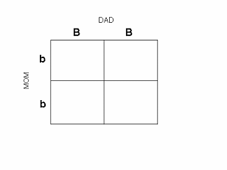
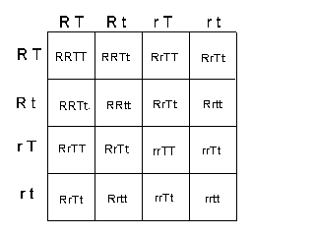
Punnett Square

Slide 16
Chromosomes
Macromolecule of DNA
Contains many genes
Usually contained in the nucleus.
Eukaryotic cells
  mitochondria and chloroplasts contain chromosomes
Human cell – 23 pairs of chromosomes (23 from dad, 23 from mom)
Males have XY chromosome
Females have XX chromosome
XYY has been attributed is a trait of several serial killers
Sperm contains X or Y
An X is always donated by a female and an X or a Y is donated by the male

Slide 17
Meiosis (haploid)
formation of a new individual by combining two haploid sex cells (gametes – sperm/egg)
Fertilization – genetic info from two separate cells (1/2 of original genetic info)
both gametes are haploid – 1 set of chromosomes
combine as a zygote with 2 sets of chromosomes
meiosis is a process to convert a diploid to a haploid gamete causing a change in genetic information to increase the diversity of offspring

Slide 18
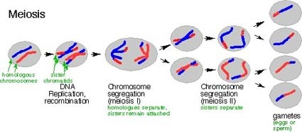
Meiosis

Slide 19
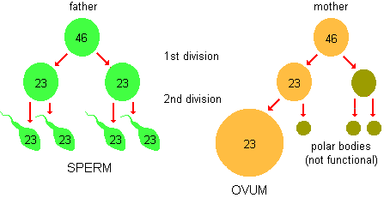
Meiosis (haploid)
Notes:
Meiosis, mitosis, DNA fingerprinting, gell electrophoresis, recombinant DNA, vectors, independent assortment

Slide 20
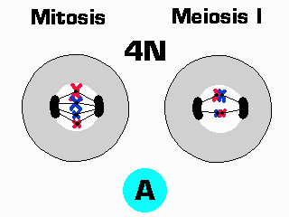
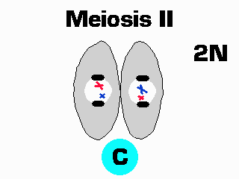
Meiosis I and II

Slide 21
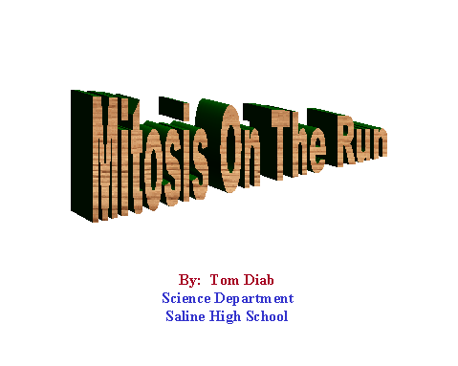
Mitosis Animation

Slide 22
Mitosis
Natural Cloning (replicates parent cell)
Cell division

Slide 23
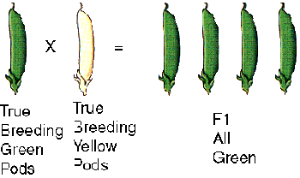
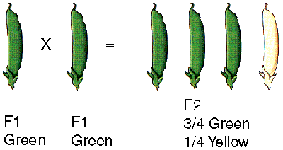
Law of Segregation
alleles are responsible for traits from each parent are separated and are randomly combined with the other parent at fertilization.
Parent provides one of the two genes for each trait

Slide 24
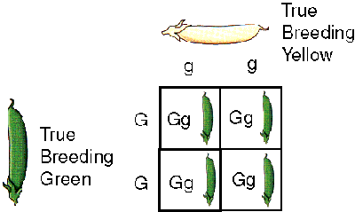
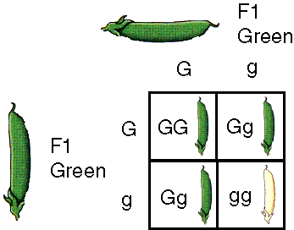
Law of Segregation
Alternative forms for genes
Each trait inherits one alternative forms from each parent. Called alleles.
Gametes- allele pairs separate or segregate leaving only 1 allele for each trait.
When 2 alleles of a pair are different, one is dominant, one is recessive.
Notes:
1. There are alternative forms for genes. This means that a gene can exist in more than one form. For example, the gene that determines pod color can either be (G) for green pod color or (g) for yellow pod color.
2. For each characteristic or trait organisms inherit two alternative forms of that gene, one from each parent. These alternative forms of a gene are called alleles13. The F1 plants in Mendel's experiment each received one allele from the green pod parent plant and one allele from the yellow pod parent plant. True-breeding green pod plants have (GG) alleles for pod color, true-breeding yellow pod plants have (gg) alleles, and the resulting F1 plants have (Gg) alleles.
(Figure C) Image Credit: Steve Berg, used with permission.
3. When gametes (sex cells) are produced, allele pairs separate or segregate leaving them with a single allele for each trait. This means that sex cells contain only half the compliment of genes. When gametes join during fertilization the resulting offspring contain two sets of alleles, one allele from each parent. For example, the sex cell for the green pod plant had a single (G) allele and the sex cell for the yellow pod plant had a single (g) allele. After fertilization the resulting F1 plants had two alleles (Gg).
4. When the two alleles of a pair are different, one is dominant and the other is recessive. This means that one trait is expressed or shown, while the other is hidden. For example, the F1 plants (Gg) were all green because the allele for green pod color (G) was dominant over the allele for yellow pod color (g). When the F1 plants were allowed to self-pollinate, 1/4 of the F2 generation plant pods were yellow. This trait had been masked because it is recessive. The alleles for green pod color are (GG) and (Gg). The alleles for yellow pod color are (gg).

Slide 25
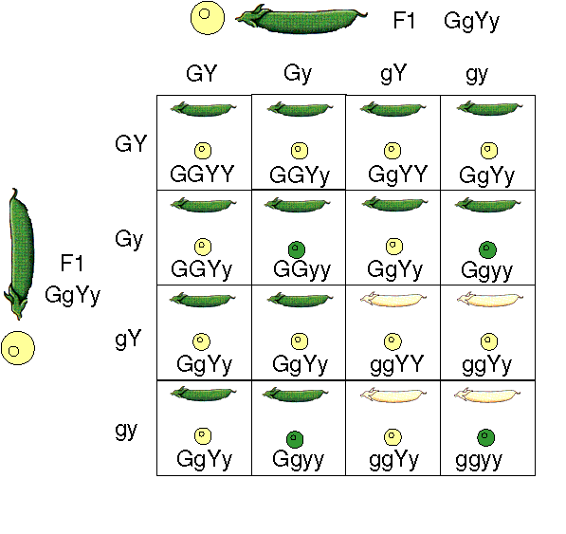
Law of Independent Assortment
allele pairs separate independently during formation of gametes.
Traits are transmitted to offspring independent of each other.
Reason why there is diversity among siblings and organisms
G – green pod, g – yellow
Y – Yellow seeds, g - green
9:3:3:1 ratio when breeding 2 heterozygous traits (Dihybrid cross)
Notes:
Example: organisms color, size, shape, growth rate, reproductive capacity all are separate traits that can be passed to the next generation in any combination.

Slide 26
Genotype and Phenotype
Genotype – genetic make up
Phenotype – physical traits
Phenotype is expressed always by dominant allele.
Phenotype = Genotype + Environment
  means that what something looks like depends on genetics AND environment!!!

Slide 27
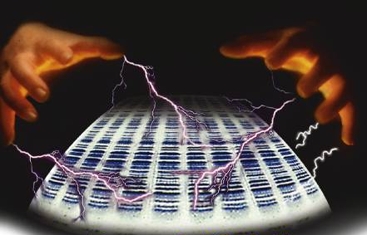
Gel Electrophoresis

Slide 28
What is it?
Electrophoresis separates DNA and Proteins using electricity through a porous material.
  Movement of the DNA and Protein is a function of size.
    DNA speed is based on size.
    Smaller is Faster and Bigger is slower.
It’s like McDonalds on a busy weekend.

Slide 29
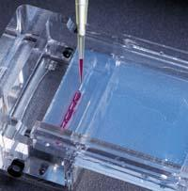
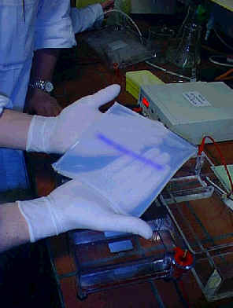
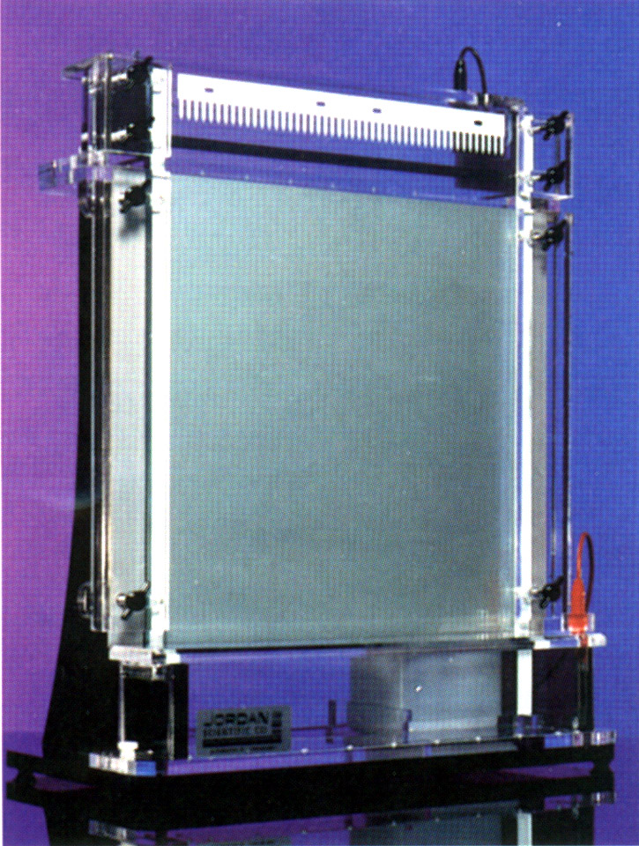
Porous Material Used
Agarose (Natural Polysaccharide)
  Most commonly used material in research.
Polyacrylamide (Synthetic Material)
  Ideal when accuracy and precision are important.

Slide 30
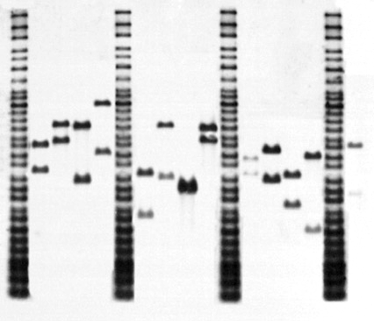
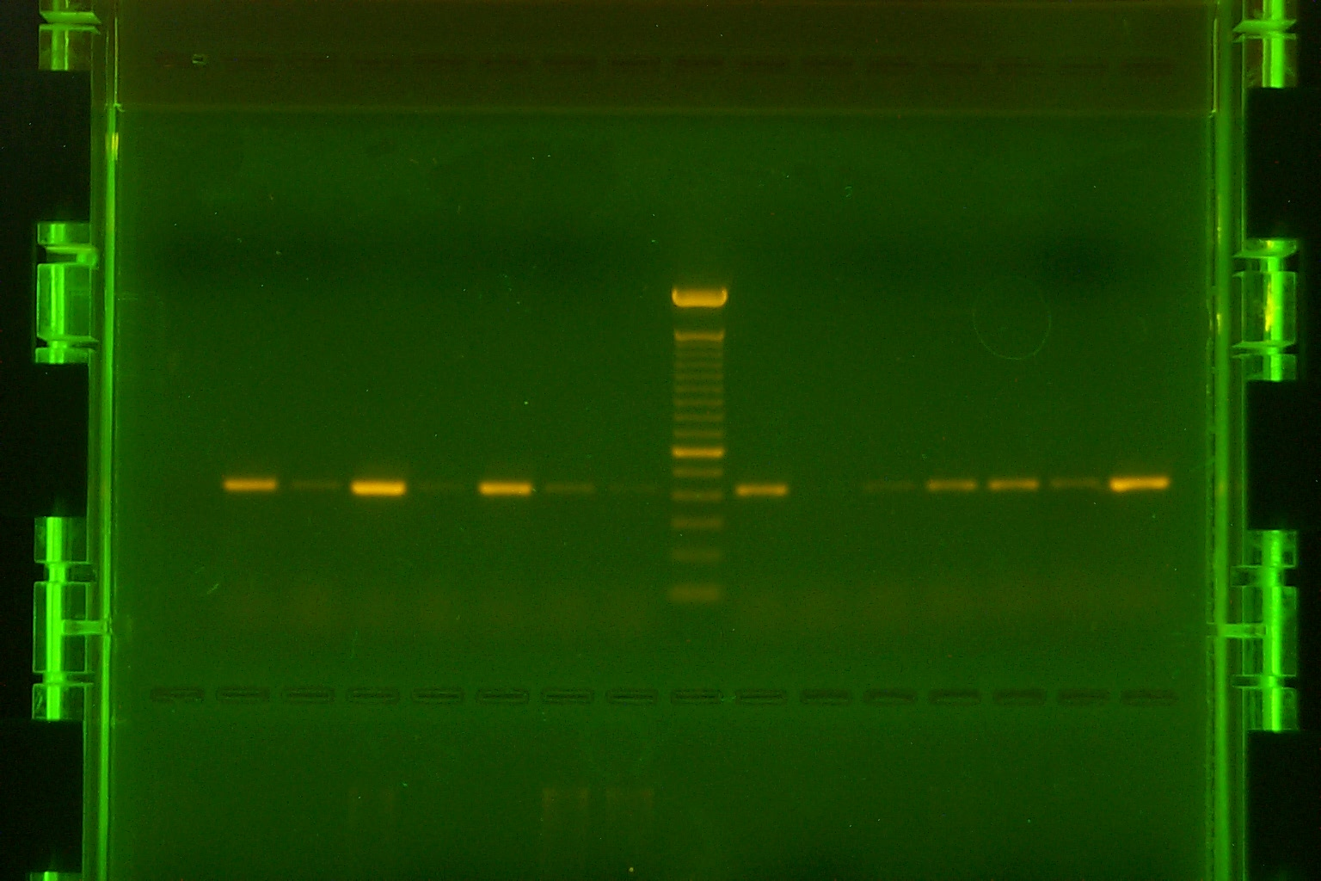
DNA Visualization
Autoradiography
  Radioisotopes
Intercalating Dyes
  Ethidum Bromide

Slide 31
